Slide 1
HIV Testing Site Monitoring Toward Certification: Implementation and Learnings from Nigeria
At The RTCQI Best Practice Workshop – Western Hemisphere, Panama City, Panama
Date: August 26-30, 2024

Slide 2
Country Phased-Approach Implementation of RTCQI
CDC-led National trainings.
IP-led State level training for IP staff, SMoH, SQIT, and HIV testers.
RTCQI Implementation:
  SPI-RT Audit (using Version 4.0)
  DTS-Based integrated PT
  Quality Control (QC)
  Log-book/Worksheet Analysis
  Test service point Certification
  Site visit and monitoring
Early 2015
* Adopted CDC ILB Training Materials.
Late FY 15
*Clustered National ToT
Abuja (21 participants)
Lagos (29 participants)
FY 16
*State-level trainings –Testers, SQIT, SMoH, and IP Staff
FY17-FY18
Scale-up across Sustained states
FY19 –Till Date
* Integrated RTCQI – HIV/RTRI
* September 2020
Early roll-out phase
Nationwide expansion phase
IP=Implementing Partner. SMoH =State Ministry of Health. SQIT= State Quality Improvement Team.

Slide 3
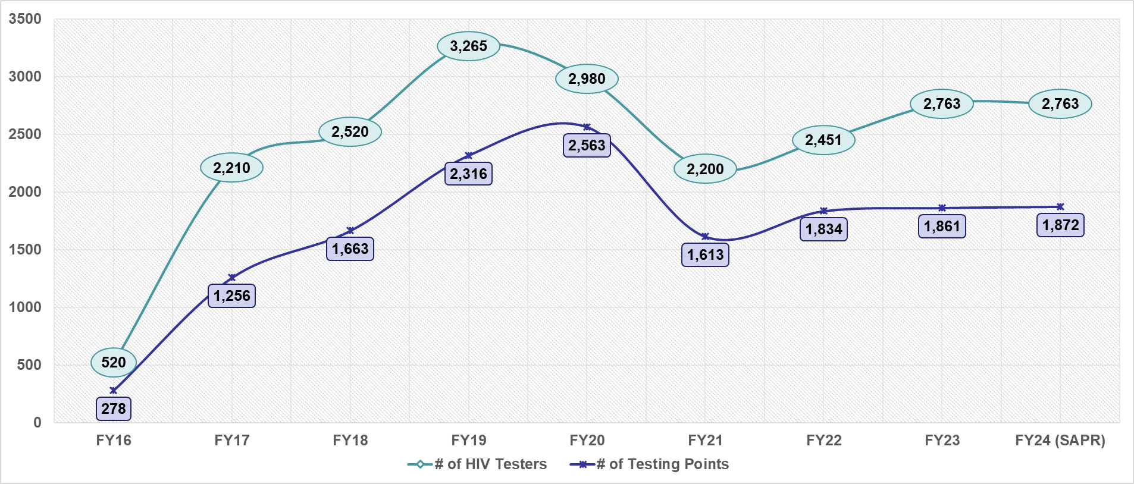
Coverage of HIV Testing Points and Testers

Slide 4
Technical Assistance/Mentoring & Site Monitoring Model
On-the-spot review and mentoring
Direct-observation-based Competency assessment
Data review and logbook analysis
SPI-RT Audit
Review documentation tools and records-keeping

Slide 5
Baseline/First Audit
Pre-Audit meeting
SPI-RRT
Non-Conformances
Action plan outlined
Communication
PDSA
Site remote support
Onsite visit/mentoring.
Follow Audit
SPI-RRT follow up.
Feedback to Facility Staff & Management
Resolution of gaps onsite
Track resolution of gaps
Audit
Post Audit Support
Resolutions of non-conformance.
(Re)training and mentoring.
Certification at level 4 – consecutively.
Approach to Site SPI-RT Audit and Site Monitoring

Slide 6
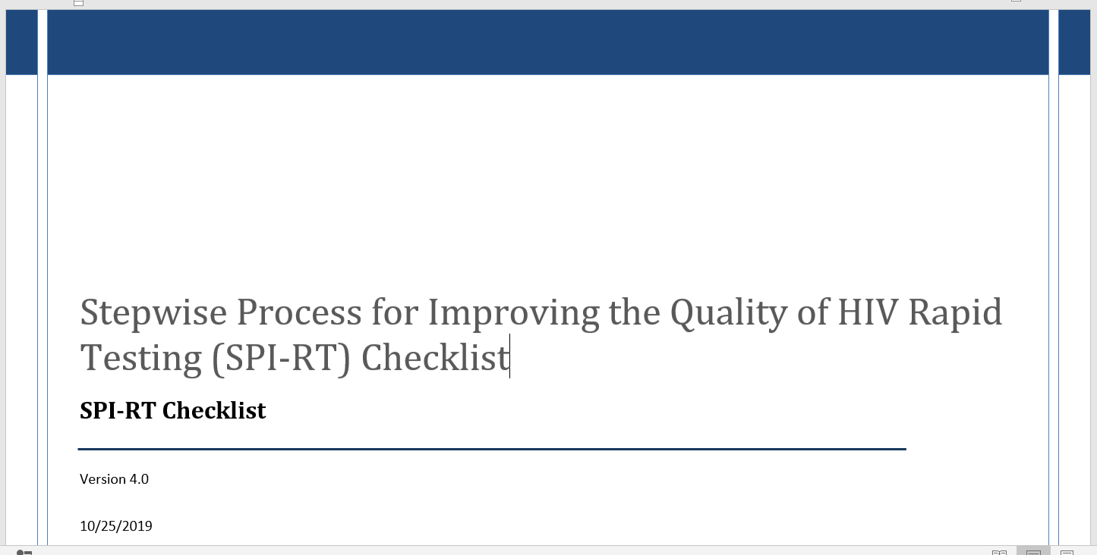
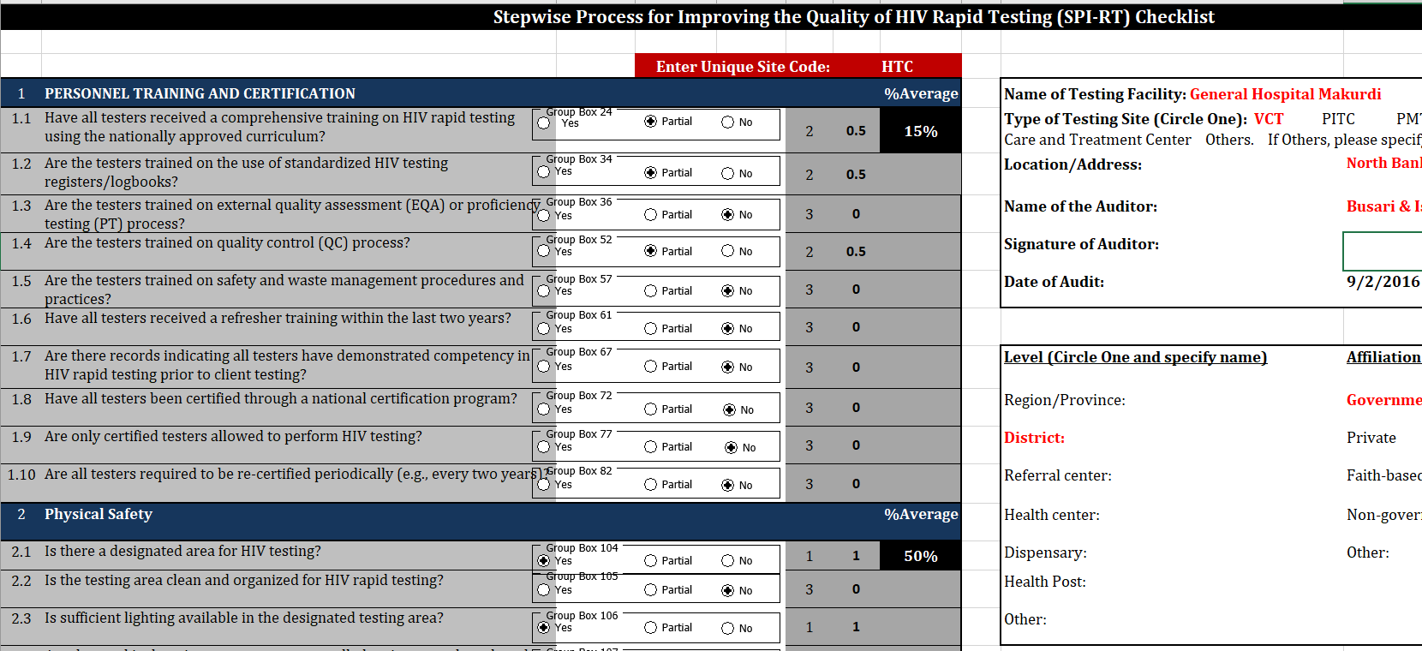
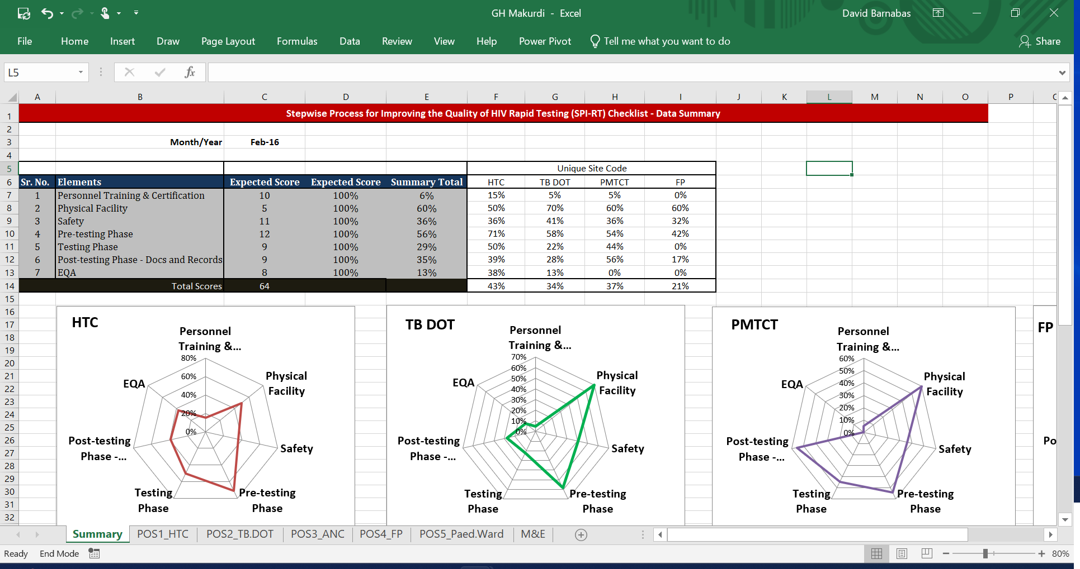
SPI-RT Audit
Involves State Quality Improvement Teams (SQIT) and Staff of SMoH.
Required for successful SPI-RT Audit and RTCQI implementation
SQIT refresher training - on-site monitoring and audit training (all-inclusive).
Biannual SPI-RT audit (twice a year).
Outline levels 3 and 4 for prioritization.
SPI-RT = Stepwise Process for Improving the Quality of HIV Rapid Testing (SPI-RT), using Checklist version 4.0.

Slide 7
Collaborations and Strategic Partnerships
Ministry of Health – SAPC and DMLS
State HIV/AIDS, Viral Hepatitis and STIs Control Programme (SASCP)
Health Facility Management
SAPC = State HIV/AIDS Program Coordinator. DMLS = Director of Medical Laboratory Services
Notes:
Civil Society on HIV and AIDS in Nigeria (CiSHAN) is a national coalition of over 5,000 indigenous civil society non-governmental organizations in Nigeria.
Network of People Living with HIV and AIDS in Nigeria (NEPWHAN) constituted in 1998. NEPWHAN and the following constituencies (ASWHAN and AYPIN)
Association of Women Living with HIV/AIDS in Nigeria (ASWHAN)
Association of Positive Youth Living with HIV/AIDS in Nigeria (APYIN) is a network of young people living with HIV/AIDS in Nigeria, constituted in June 2005.

Slide 8
Level 4 at First Audit
Outline testing point at level 4.
Engage SMoH
Scheduled a follow up Audit
Site remote support
Onsite visit/mentoring.
Follow Audit
Deployed Mapped SQIT and SMoH Auditors
Outline report and testing points at Level 4
List of testing points at Level 4
Track resolution of gaps
Certification/Post Audit Support
Resolve non-conformities.
Re-training and mentoring (level ≤3)
Certification of TPs at level 4 – consecutively.
List of TPs to SMoH/SAPC
Approach for Follow-Up SPI-RT Audit and Site Certification

Slide 9
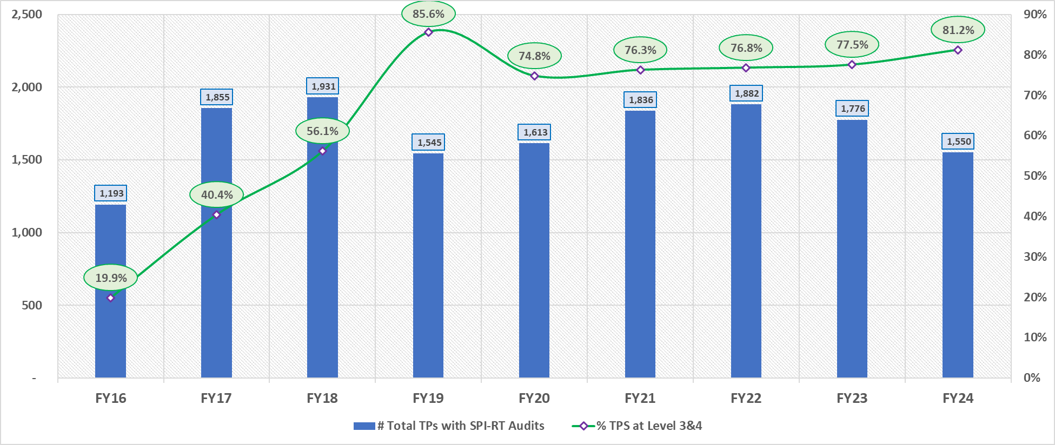
SPI-RT Audit Outcome and Trend (Level 3 &4)
#TPs= Number of Testing Points:

Slide 10
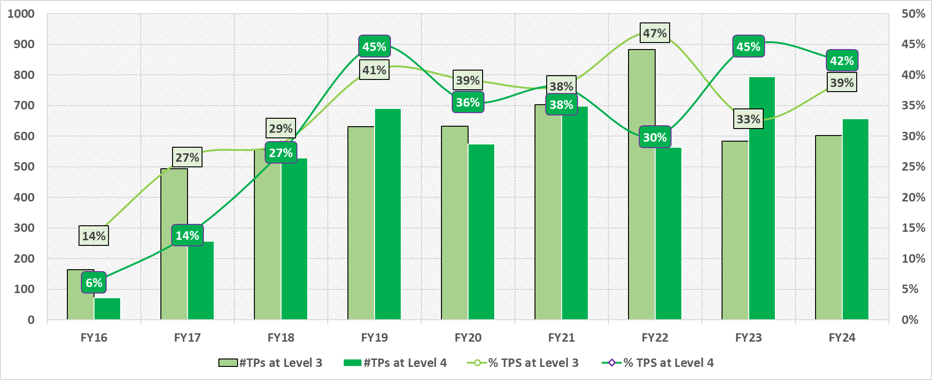
SPI-RT Audit Outcome and Trend (Level 3 and 4)
#TPs= Number of Testing Points:

Slide 11
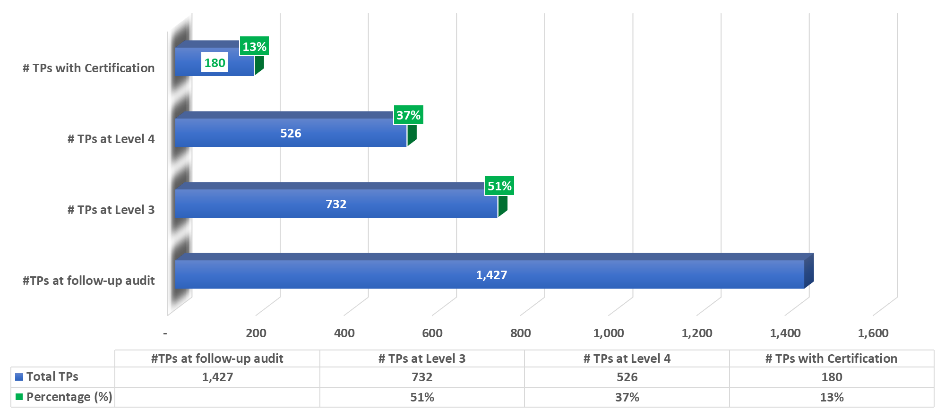
Testing Points at Level 4 and Number Certified by GoN (SASCP)
#TPs= Number of Testing Points:

Slide 12
Key Results
Percentage TPs at SPI-RT audit:
  At levels 3 & 4: Increased from 19.9% to 81.2% (as of March 2024). Representing a 308.0% increase.
  At level 4: Increased from 16% to 42% (2024). Representing a 593% increase.
Quality of HIV testing has been sustained: from 278 (in 2016) to 1,872 (in 2024).
At least, 180 (13%) TPs are already certified by SMoH, within FY24 alone.
TPs = Testing Points

Slide 13
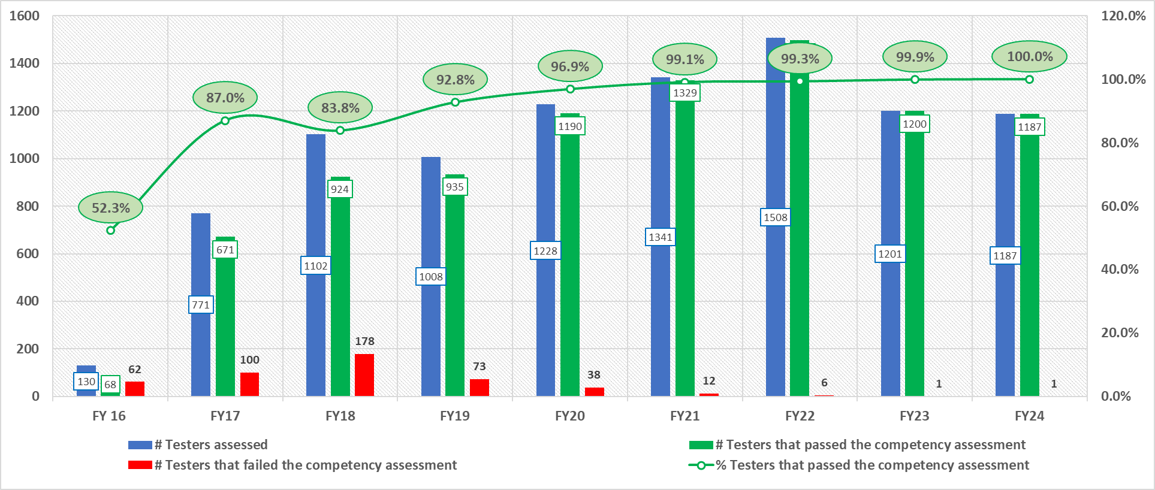
Testers’ Competency Assessment During SPI-RT Audit

Slide 14
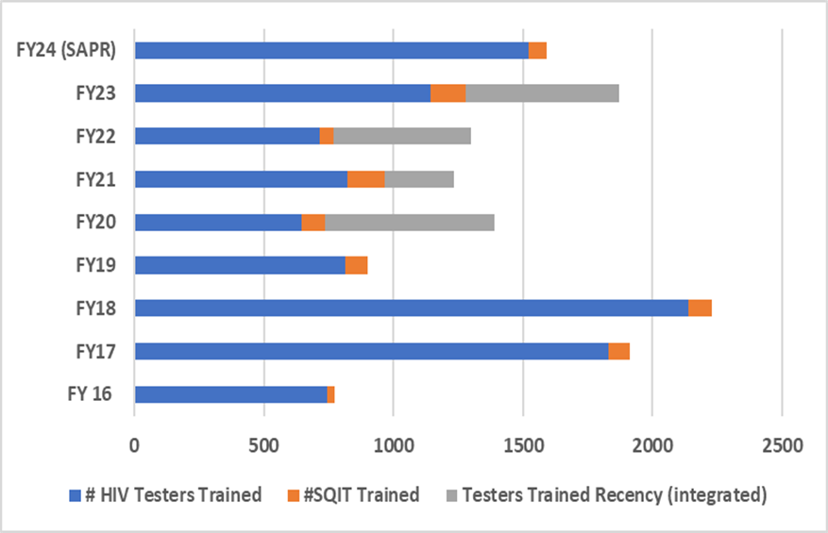
National Training, Retraining, and Step-Down Trainings (2)
Trained at least 11,152 HIV testers including 771 *SQIT.
Excludes 2, 045 testers trained in Recency and HIV testing (integrated)
*SQIT= State Quality Improvement Team

Slide 15
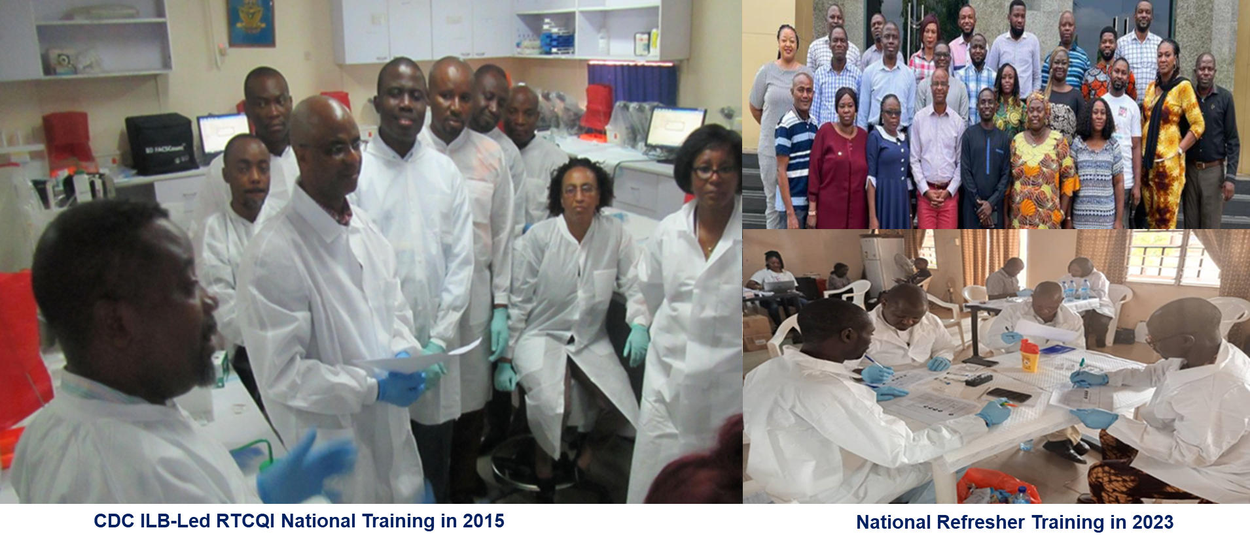
National Trainings, Retraining, and Step Down Trainings

Slide 16
Lessons Learned, Benefits, and Opportunities
Instill confidence (quality) of HIV test results.
Government involvement – through advocacy and inclusion in RTCQI activities.
Increase the visibility of the RTCQI program to ‘non-technical actors’ towards ownership and sustainability.
It inspires response(s) to resolving identified non-conformities.
Motivation for Testers and State Quality Improvement Teams (SQIT).
Provides a basis for tailored RTCQI-focused (re)training.
An advocacy platform to expand the RTCQI concept to other programs.

Slide 17
Program Challenges and Recommendations/Actions
S/N | Program Challenges | Actions
1. | Slow paced of Tester’s Certification Programs | Continuous engagement with FMoH Sustained advocacy to SMoH and HMB
2. | High attrition among testers. | Continuous Training
3. | State-based and peculiar needs/jurisdiction | Reversion to SASCP
 | Retirement and or redeployment of Government Officials | Expand the scope of engagement and writing through the Hon Commissioner’s Office.

Slide 18







The Certification program(recognition) of HIV testing points is not just a pillar of RTCQI, but a huge motivation (to testers) for quality HIV testing.
Thank you
Acknowledgement:

